Slide 1
Clap
Clap
Revolution

Slide 2
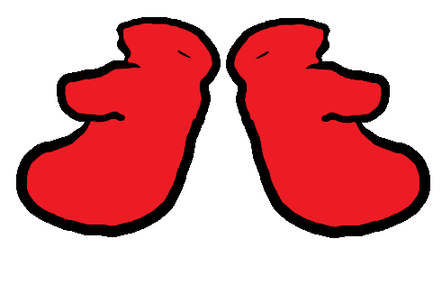
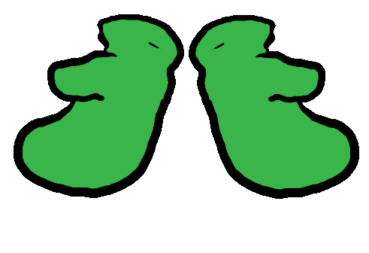
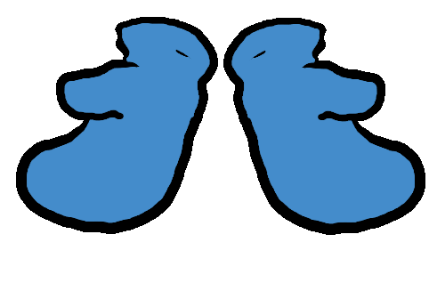
Twinkle Twinkle
Little Star
Hot Cross Buns
Yankee Doodle

Slide 4
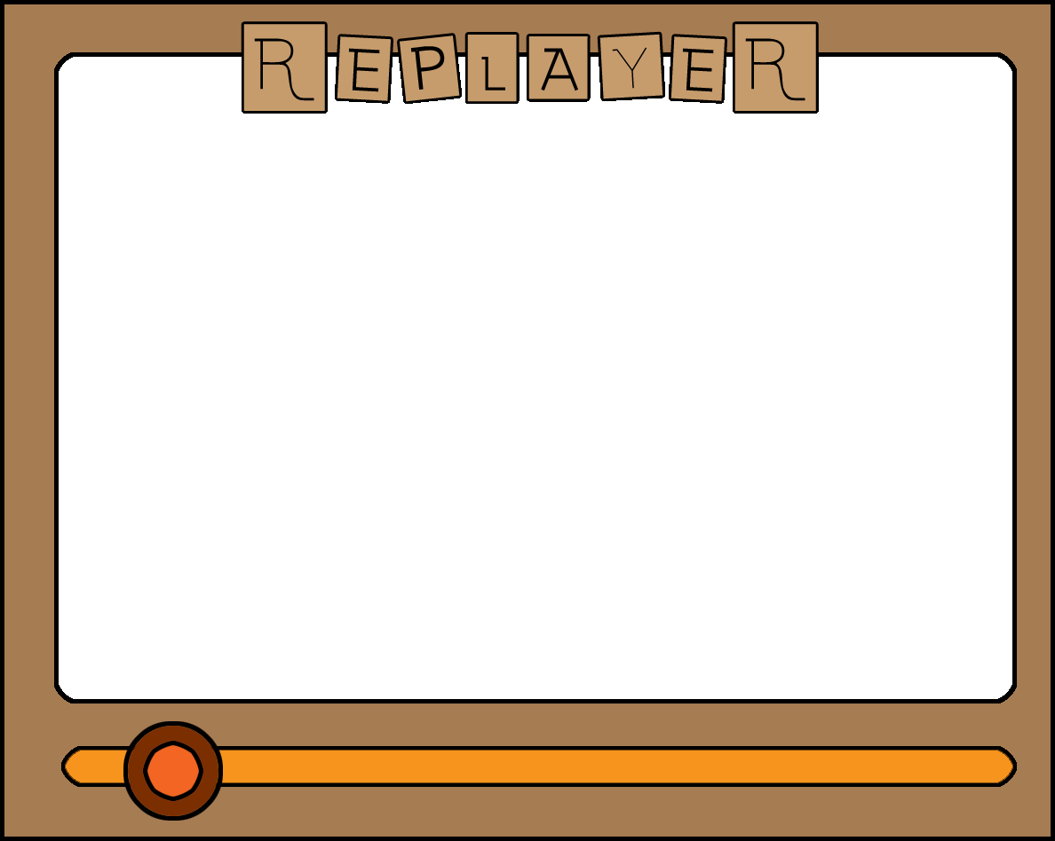
Play
Again
Select
Song

